Slide 1

Final Presentation: MaidEase
Team 1 - Rushda Mansuri Tahera Shaikh Nidhi Berde Amala Natu Bhakti Palkar Jahid Hassan Sai Manish Avasarala Sai Teja Malladi

Slide 2
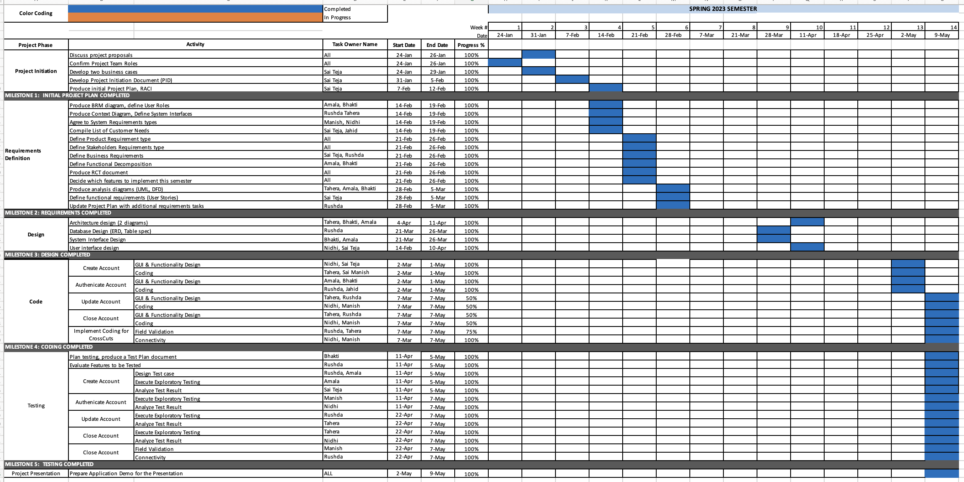
Project Plan

Slide 3
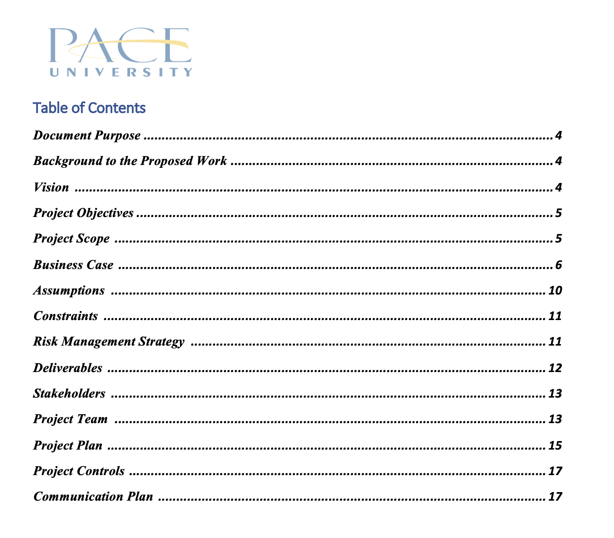
PID Document
BRM Diagram, User Roles - Aleksander Kamenev

Slide 4
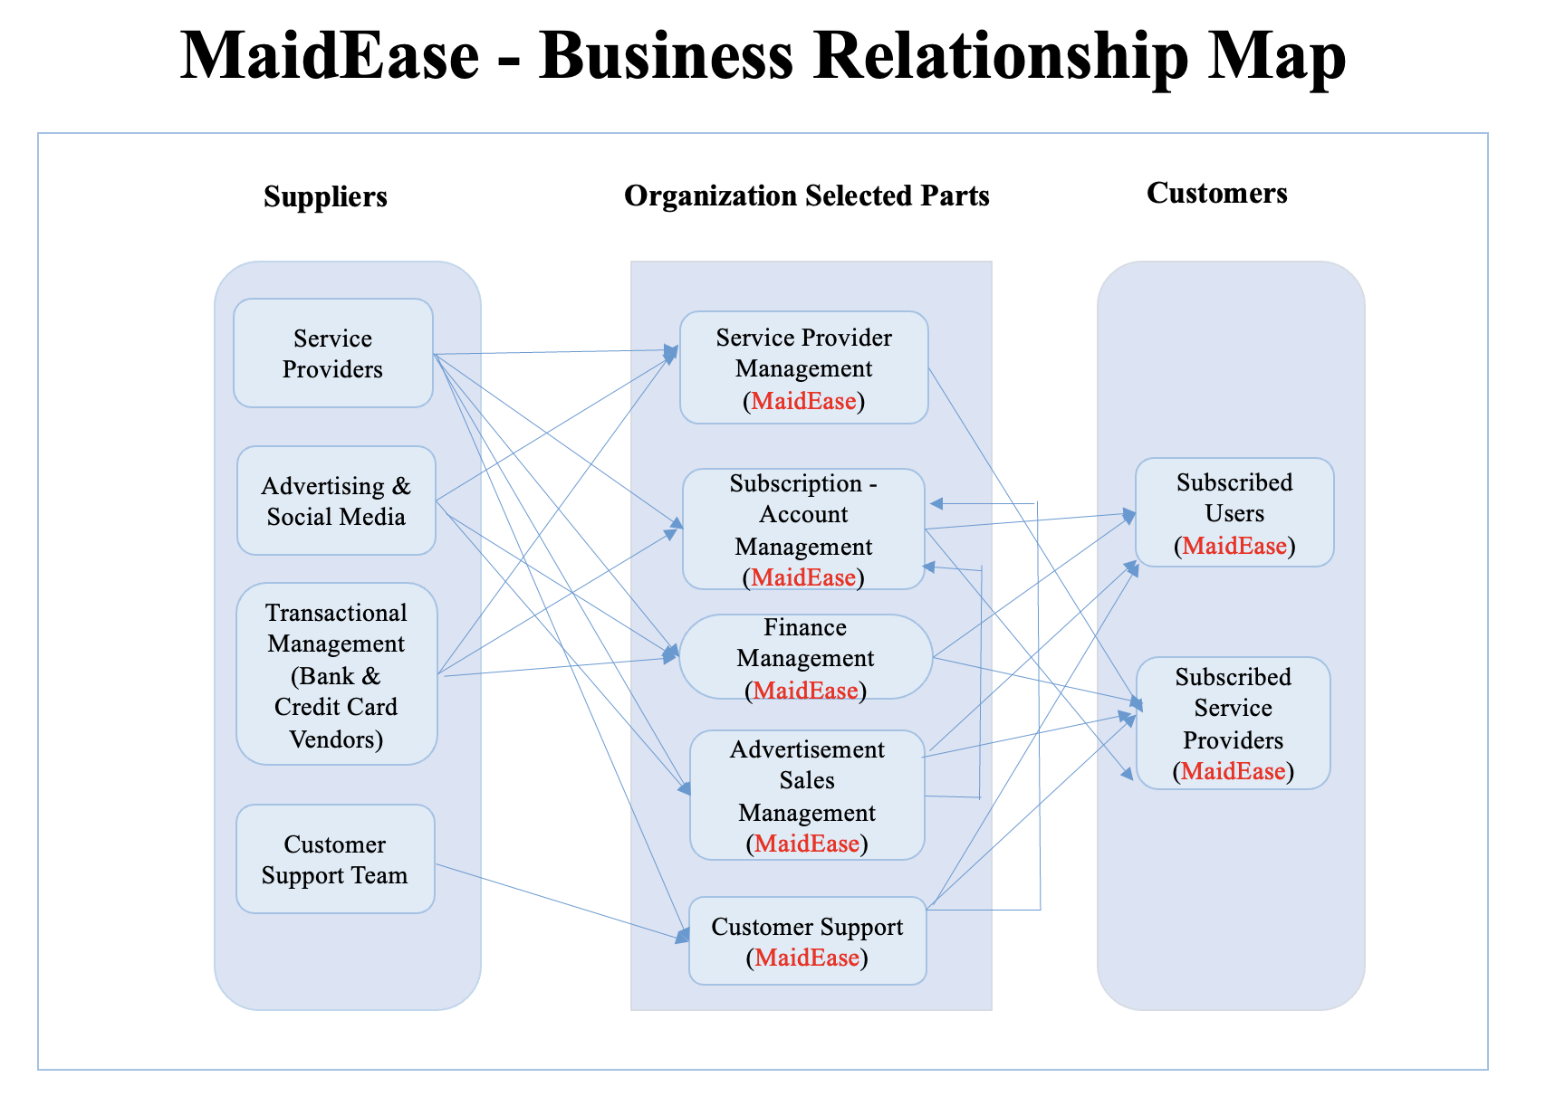
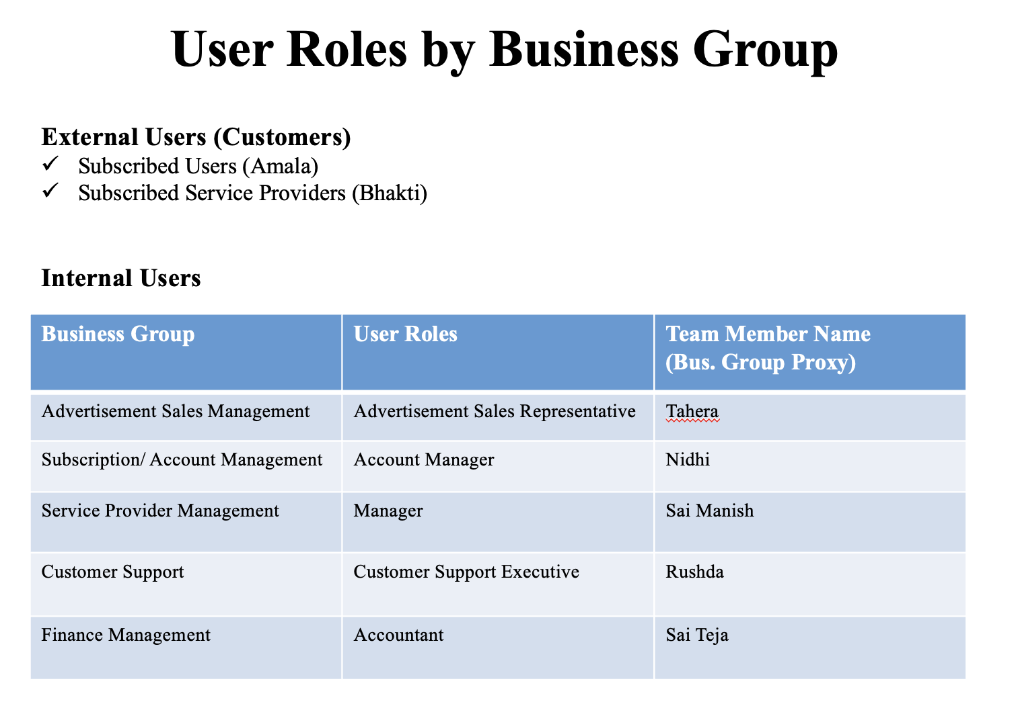
BRM Diagram, User Roles -Rushda Mansuri

Slide 5
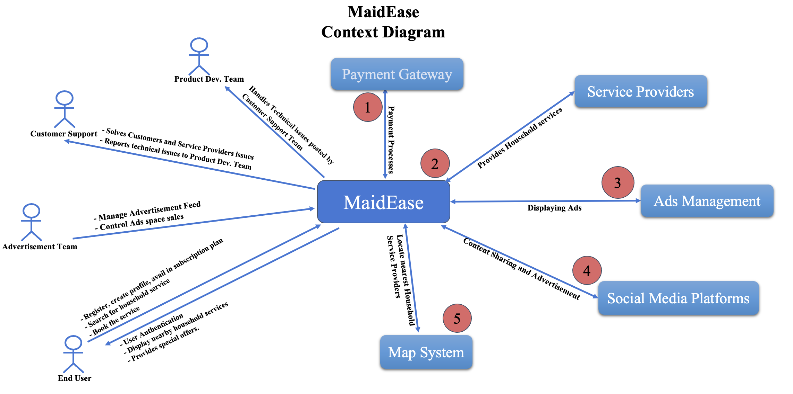
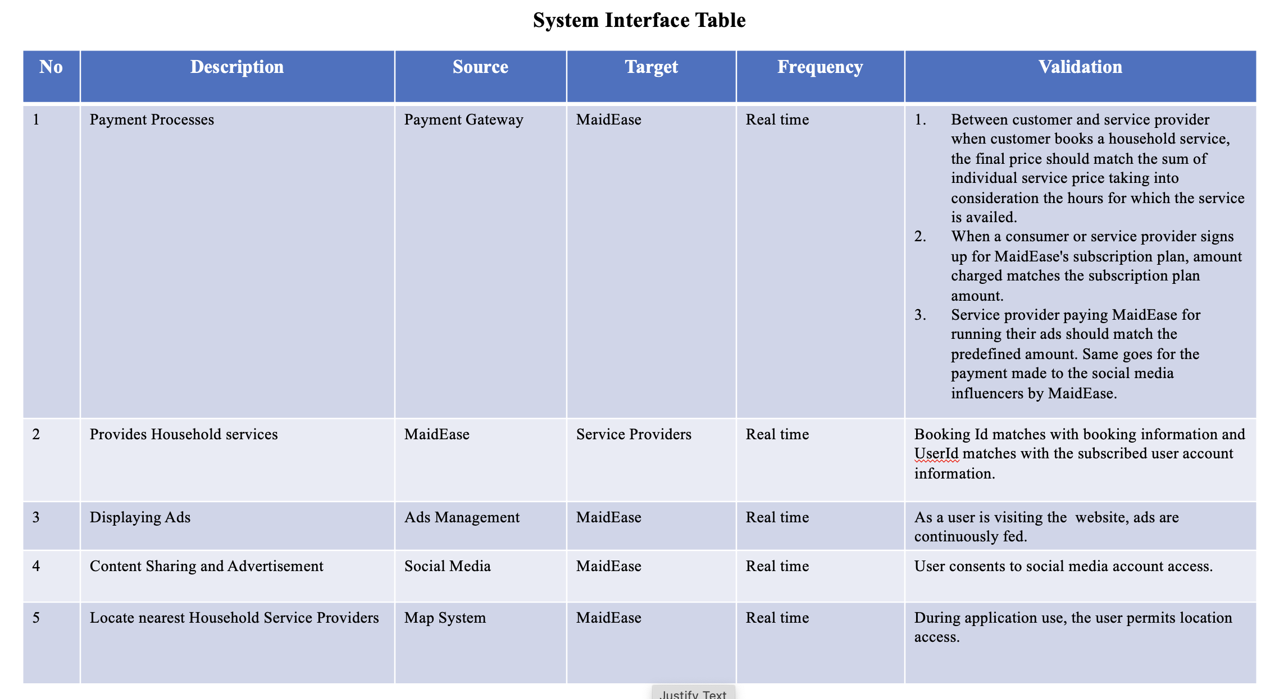
Context Diagram, System Interface Table -Tahera Shaikh

Slide 6
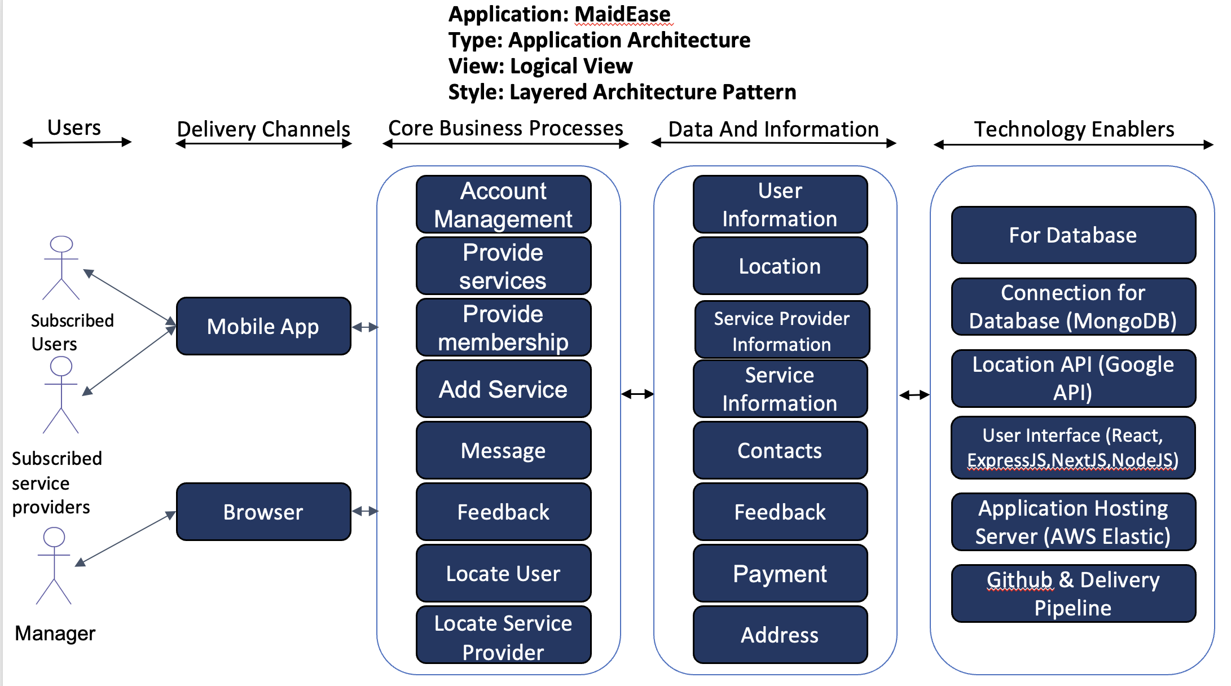
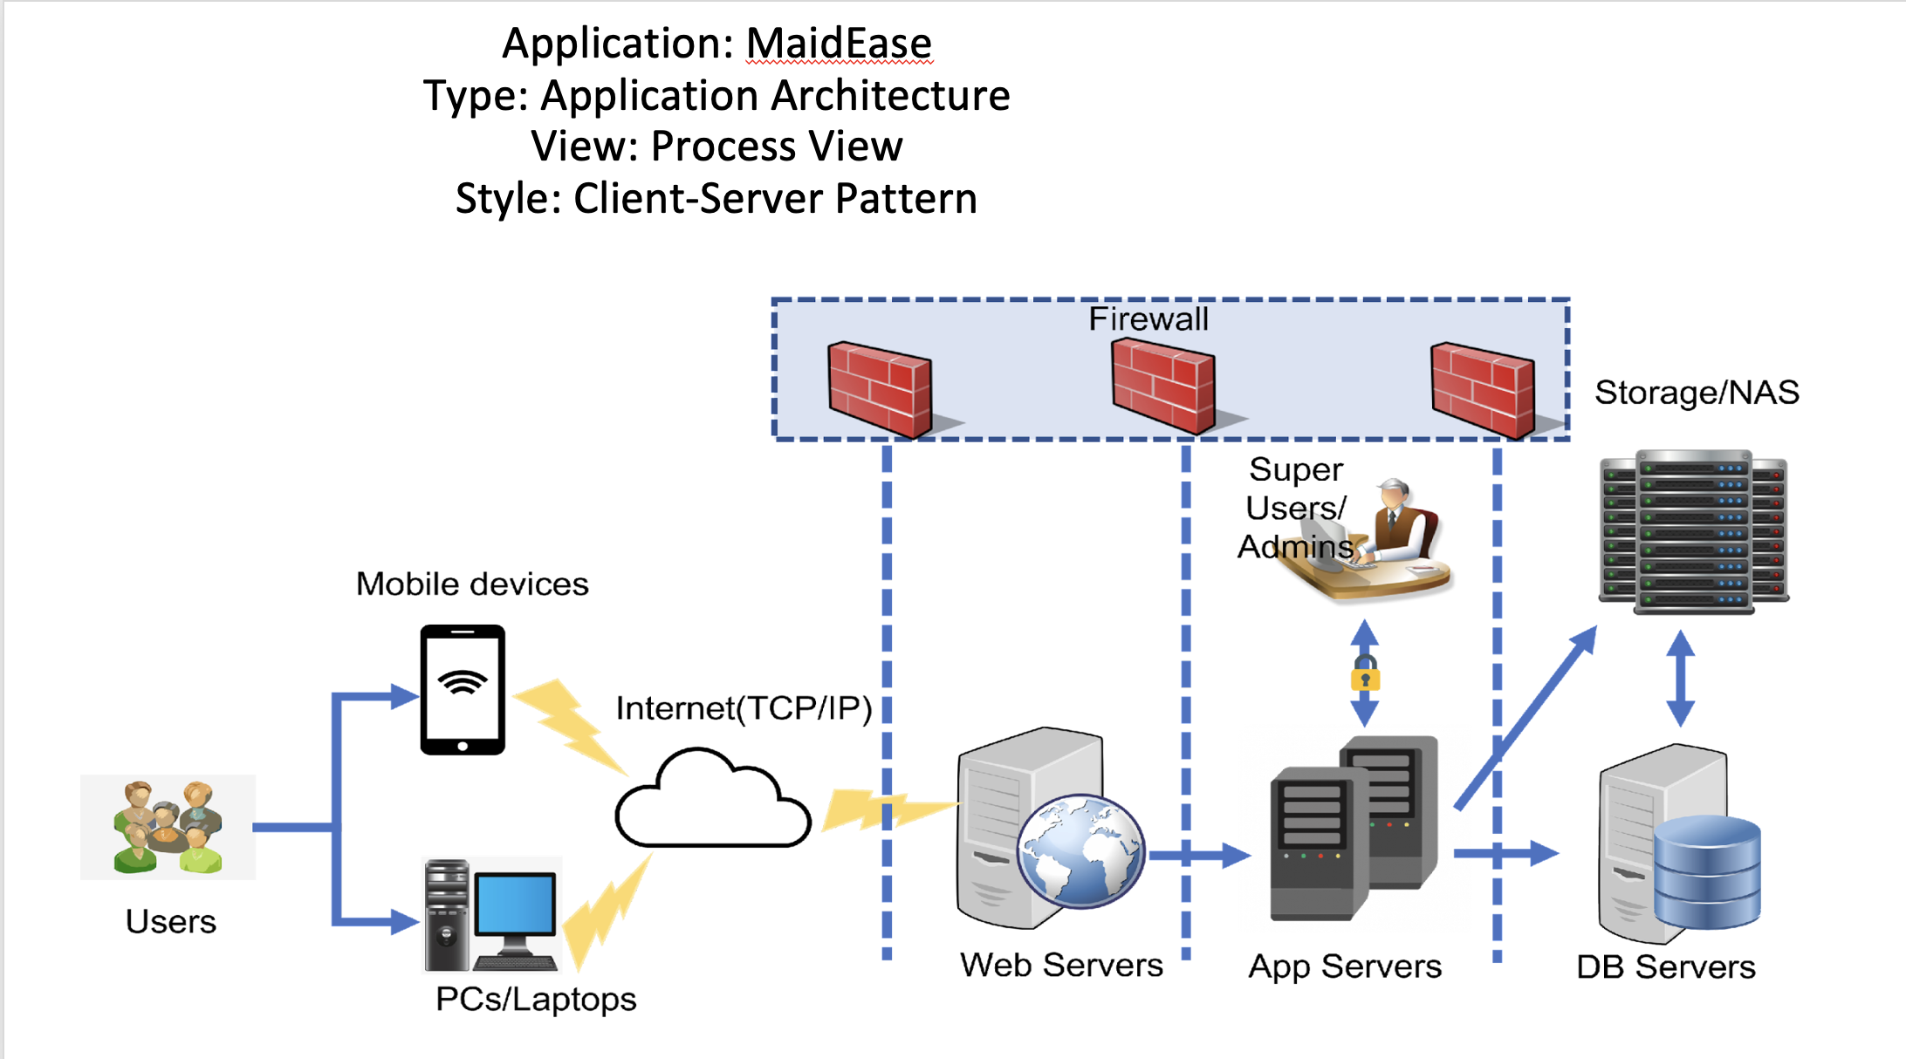
Architecture Diagram (Logical & Process Views) -Bhakti Palkar

Slide 7
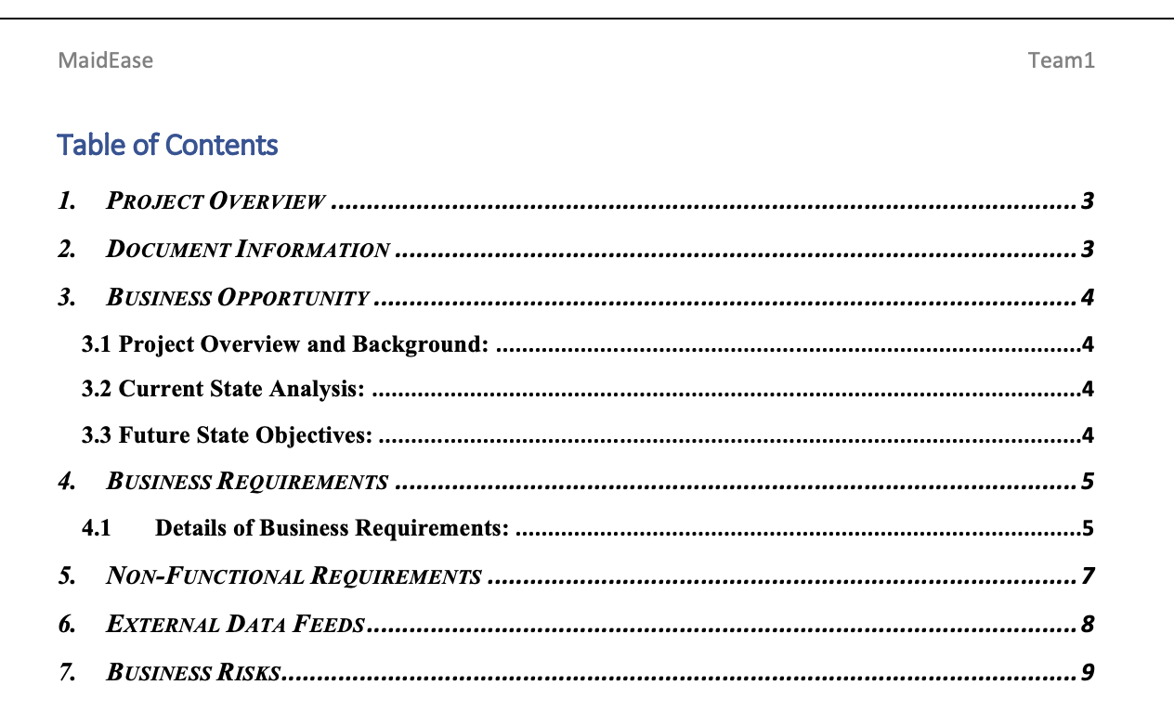
Business Requirements

Slide 8
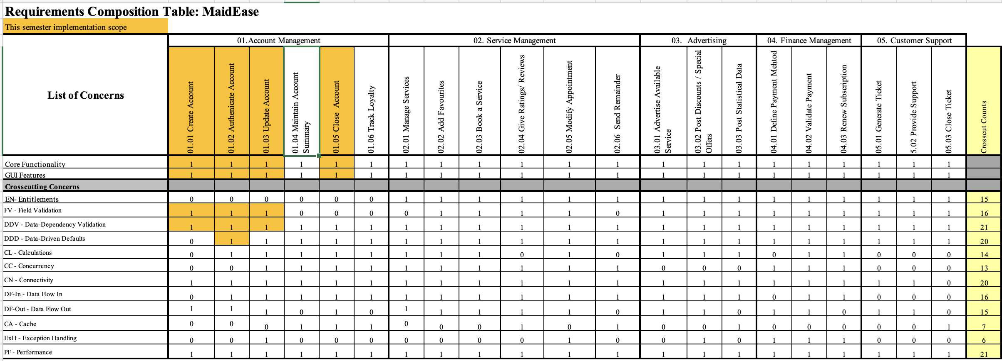
RCT -Sai Manish Avasarala

Slide 9
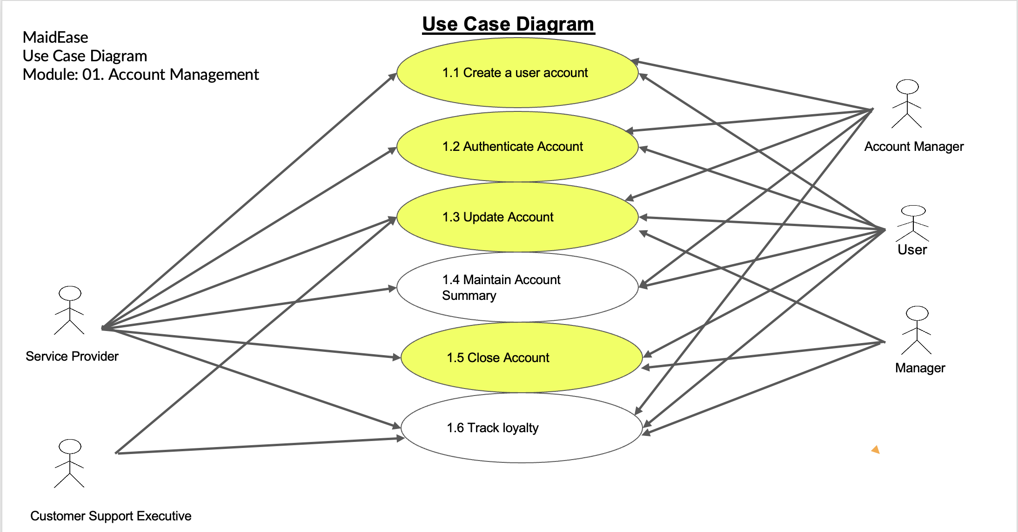
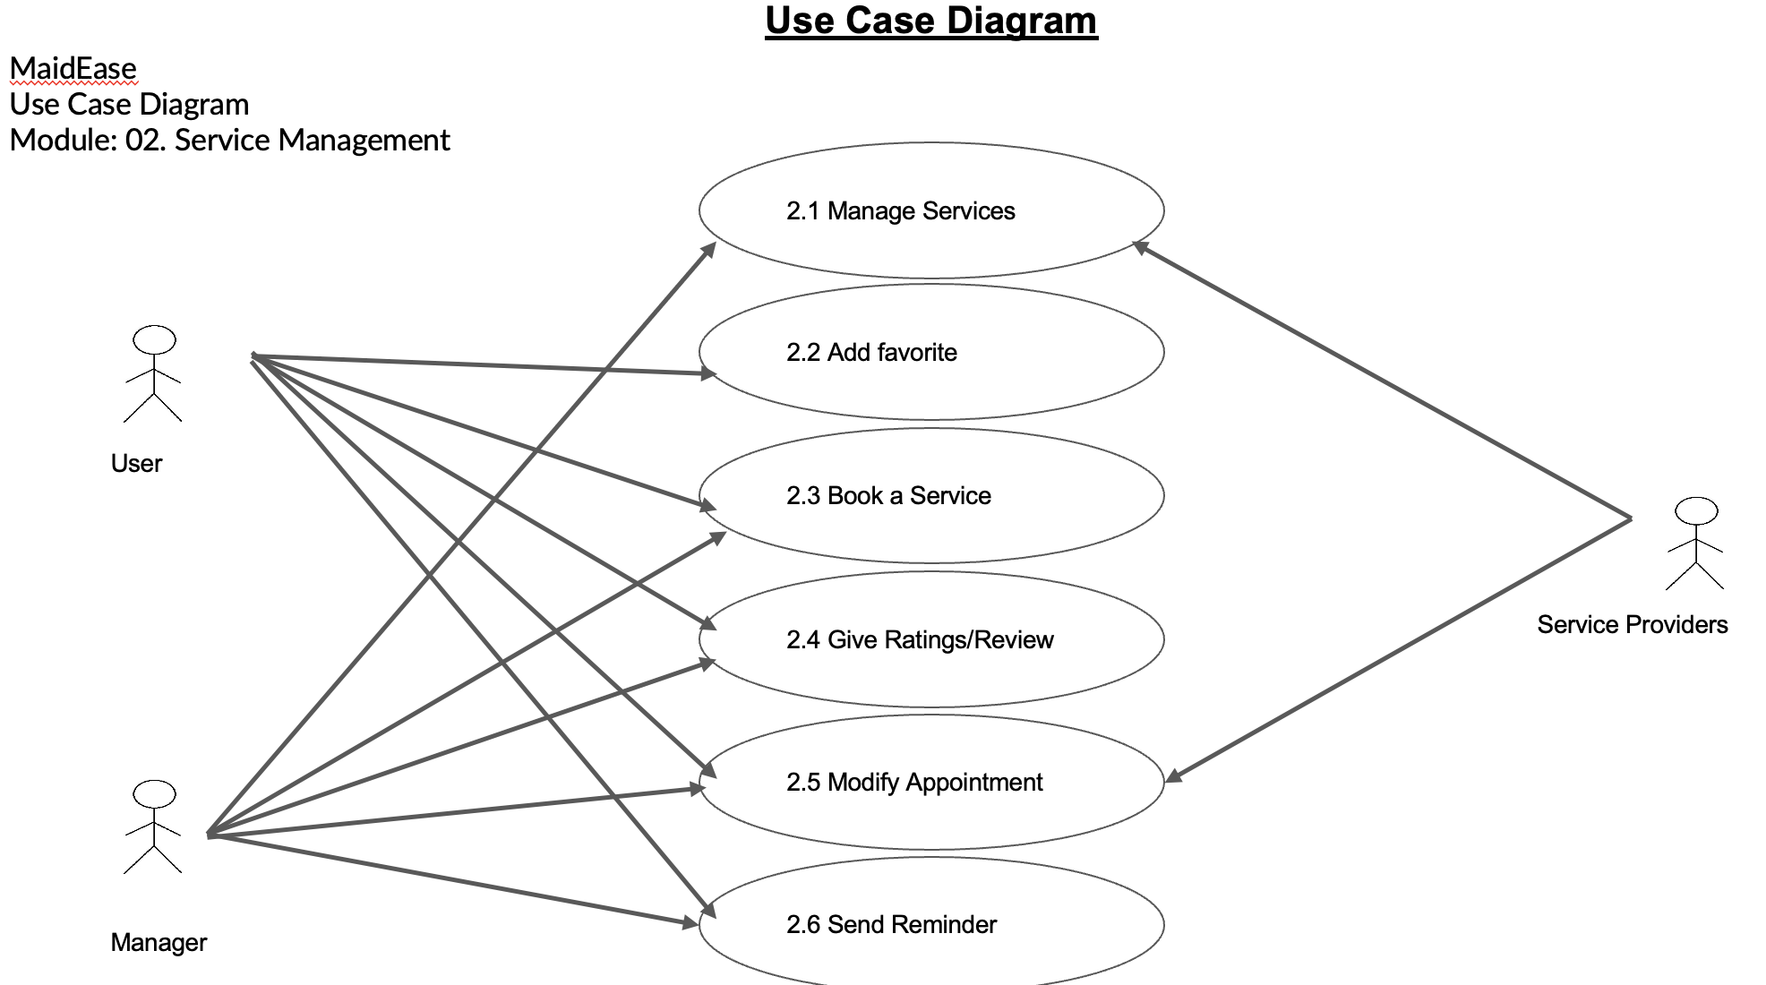
UseCase Diagram -Jahid Hassan

Slide 10
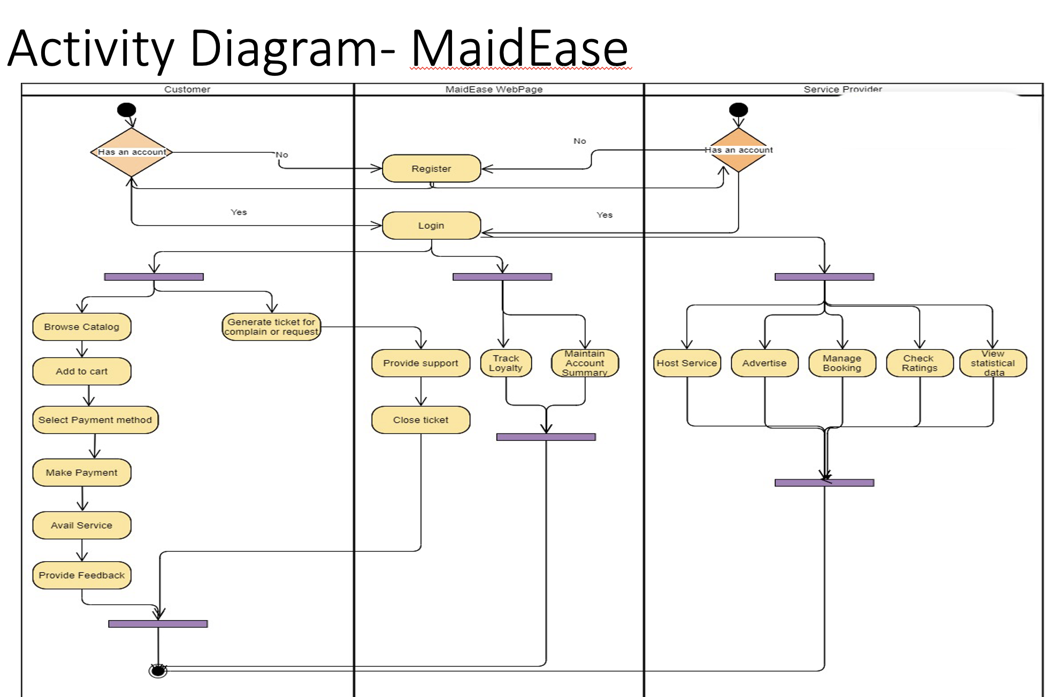
Activity Diagram -Nidhi Berde

Slide 11
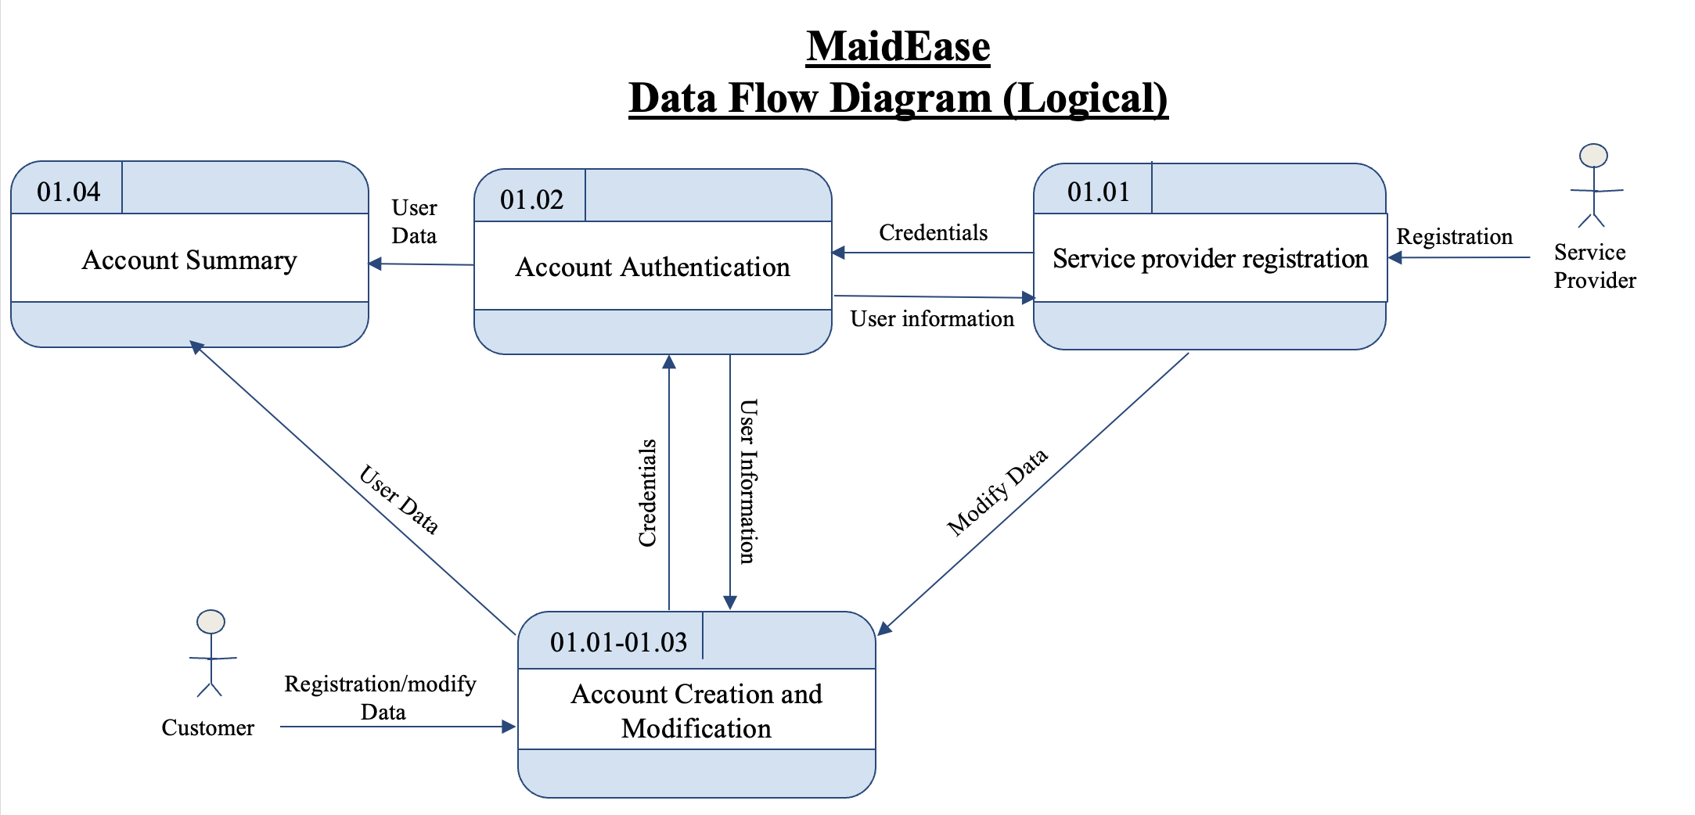
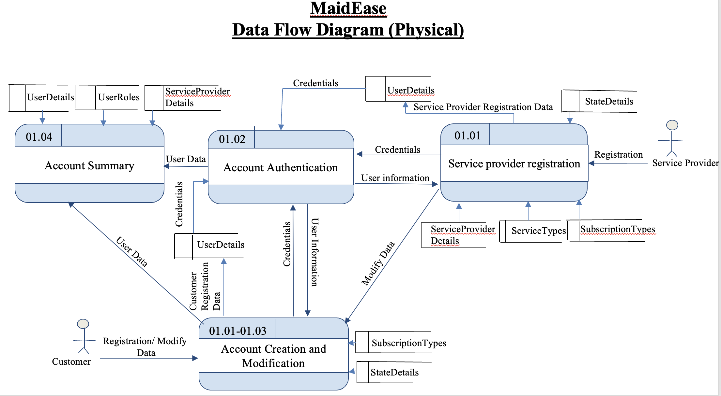
Dataflow Diagrams – Logical, Physical -Amala Natu

Slide 12
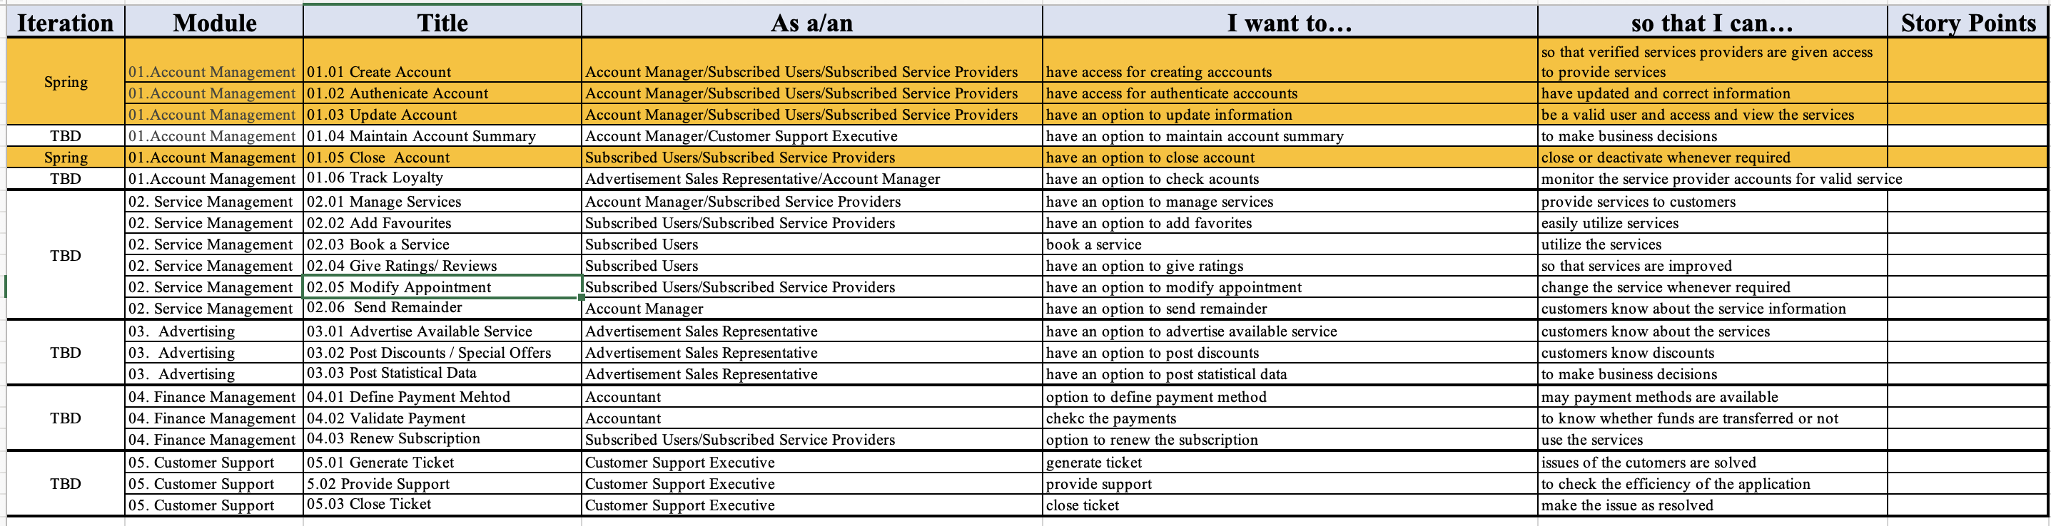
Functional Requirements (User Stories) -Tahera Shaikh

Slide 13
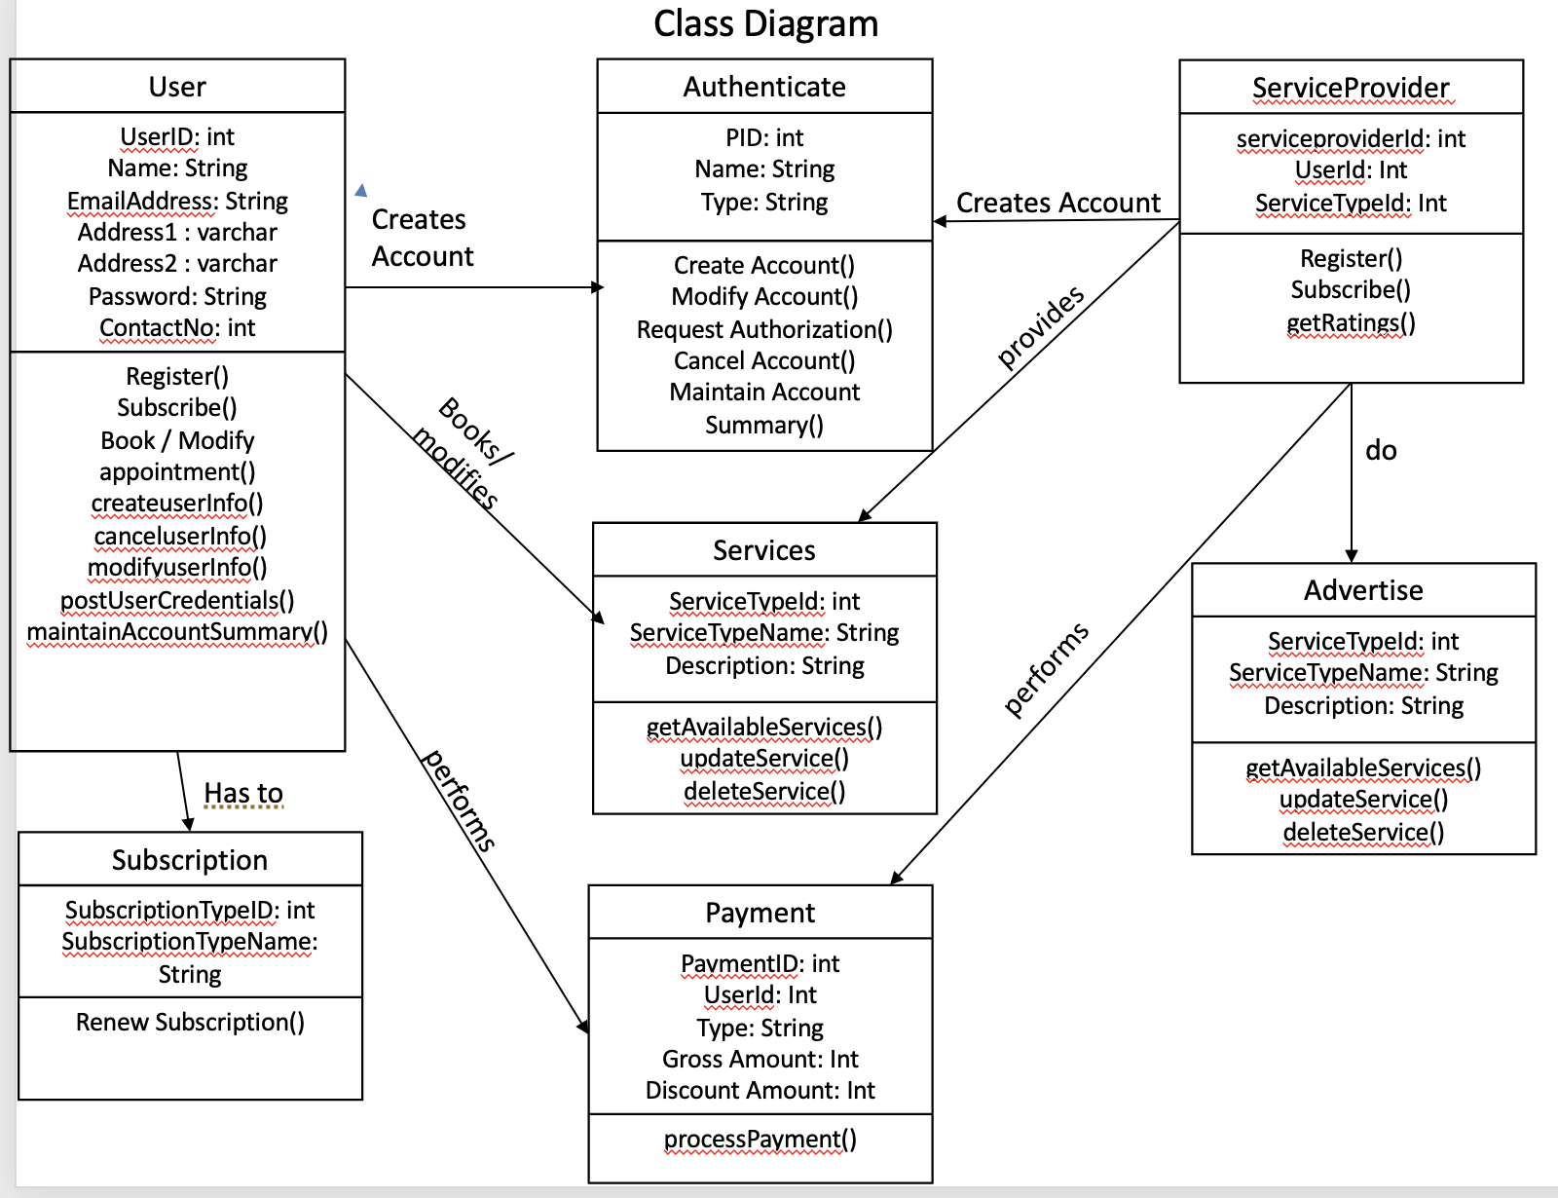
Class Diagram

Slide 14
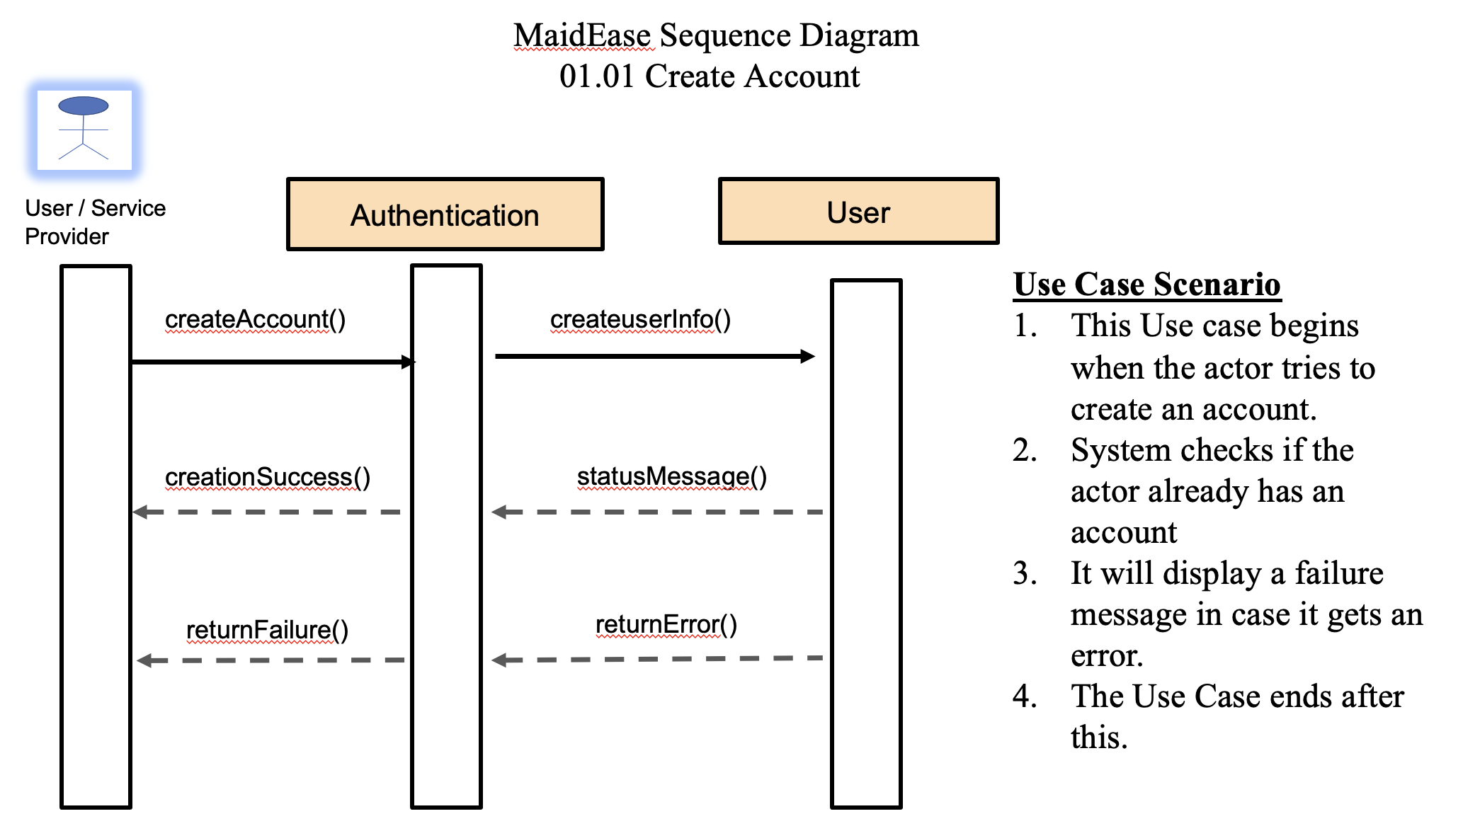
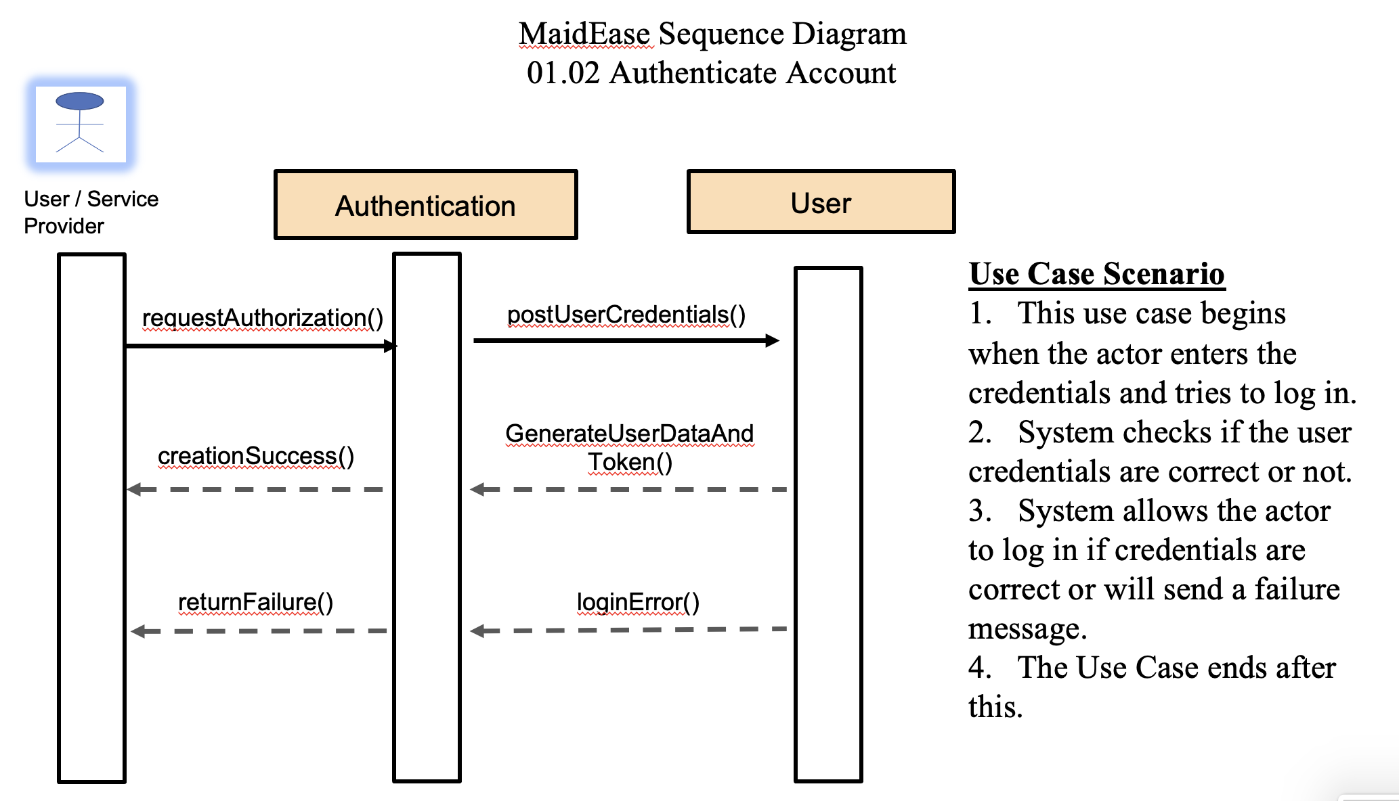

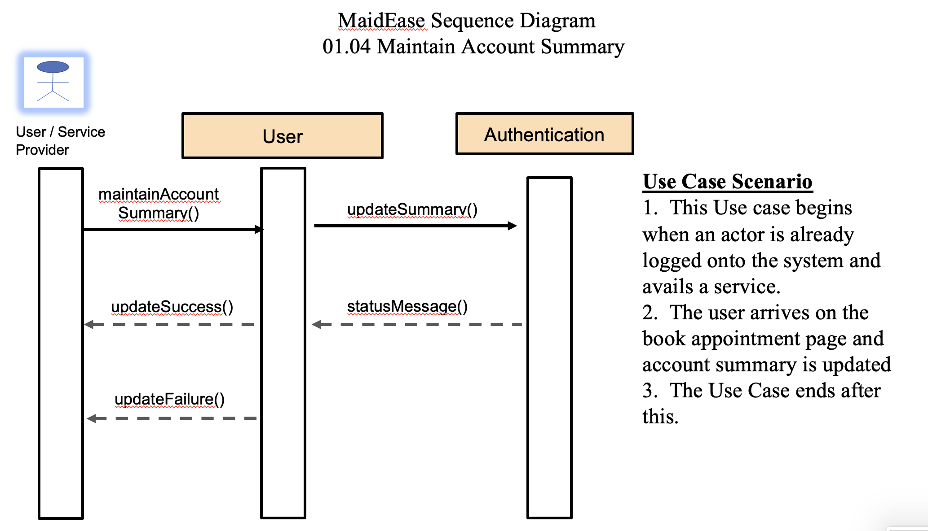
Sequence Diagrams

Slide 15
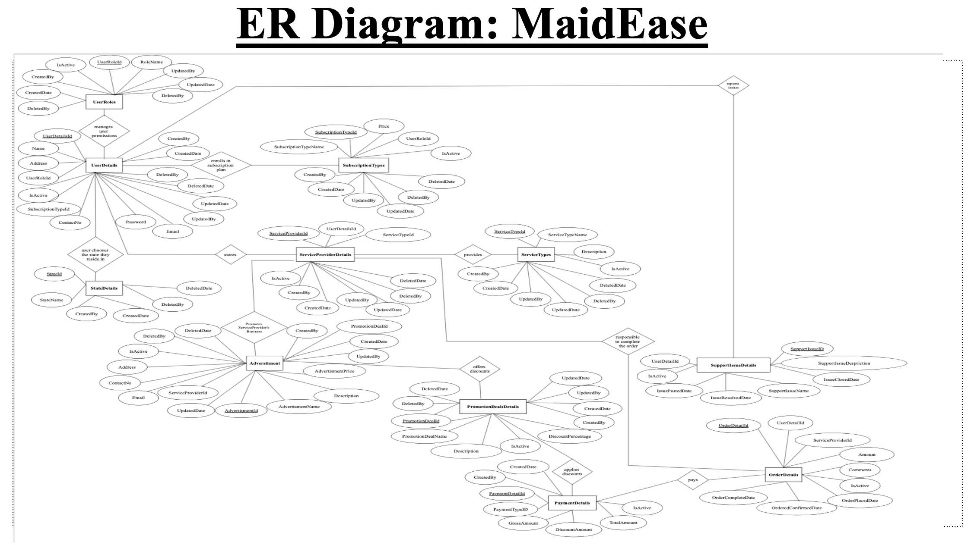
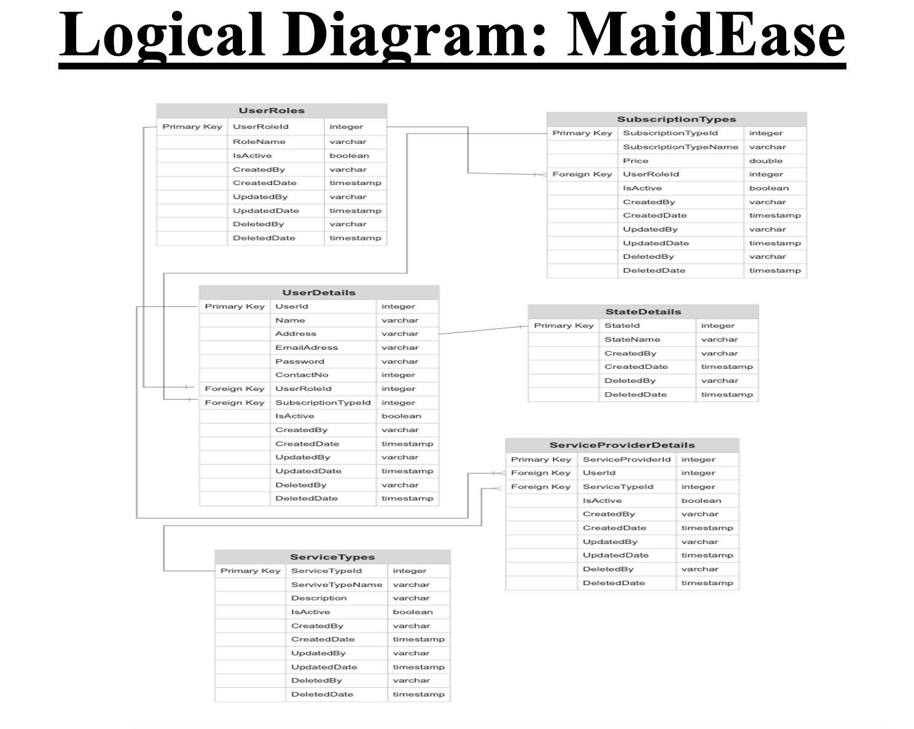
ER Diagrams (Conceptual, Logical)
-Sai Teja Malladi

Slide 16
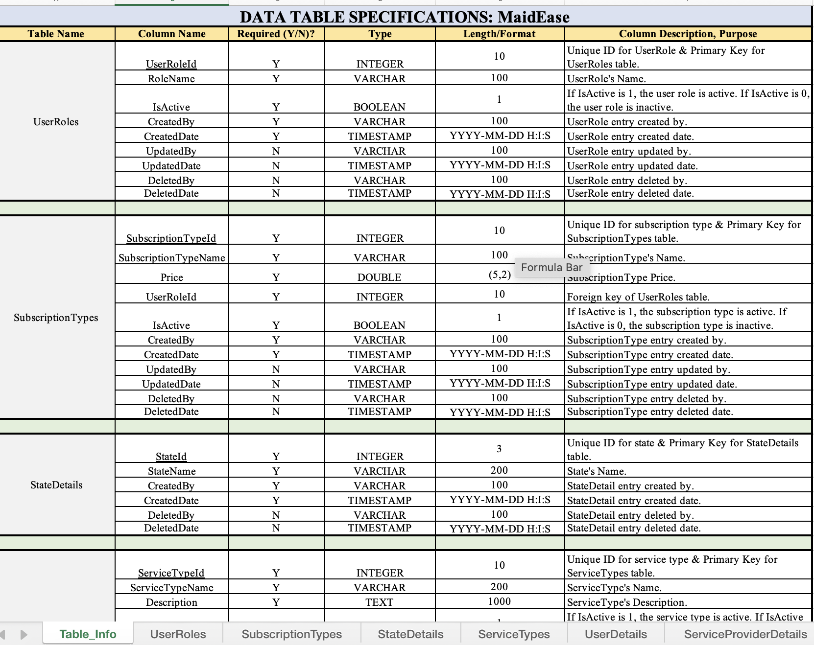
Table Specification

Slide 17

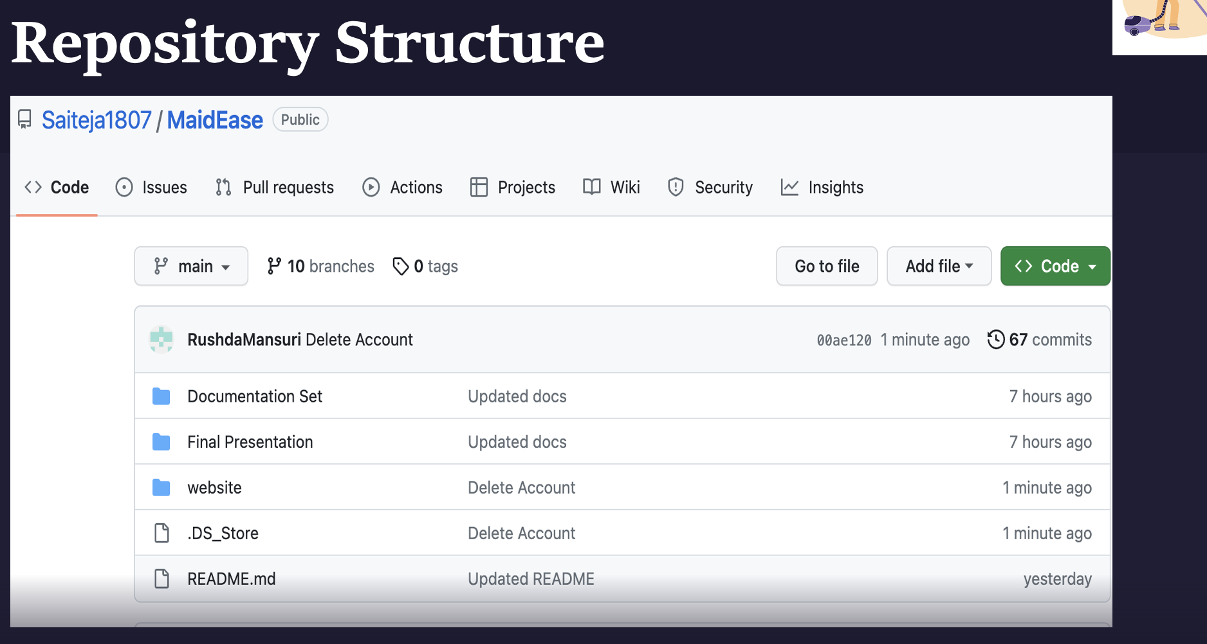
Source Code + GitHub Repository
-Rushda Mansuri

Slide 18
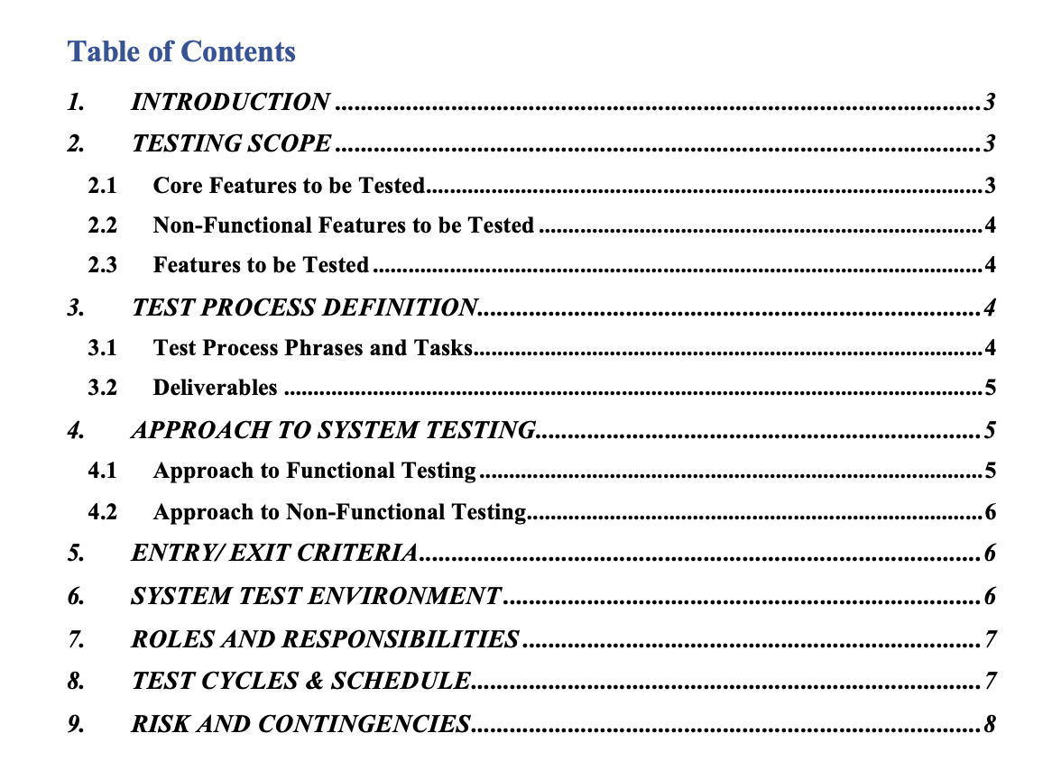
Test Plan
-Jahid Hassan

Slide 19
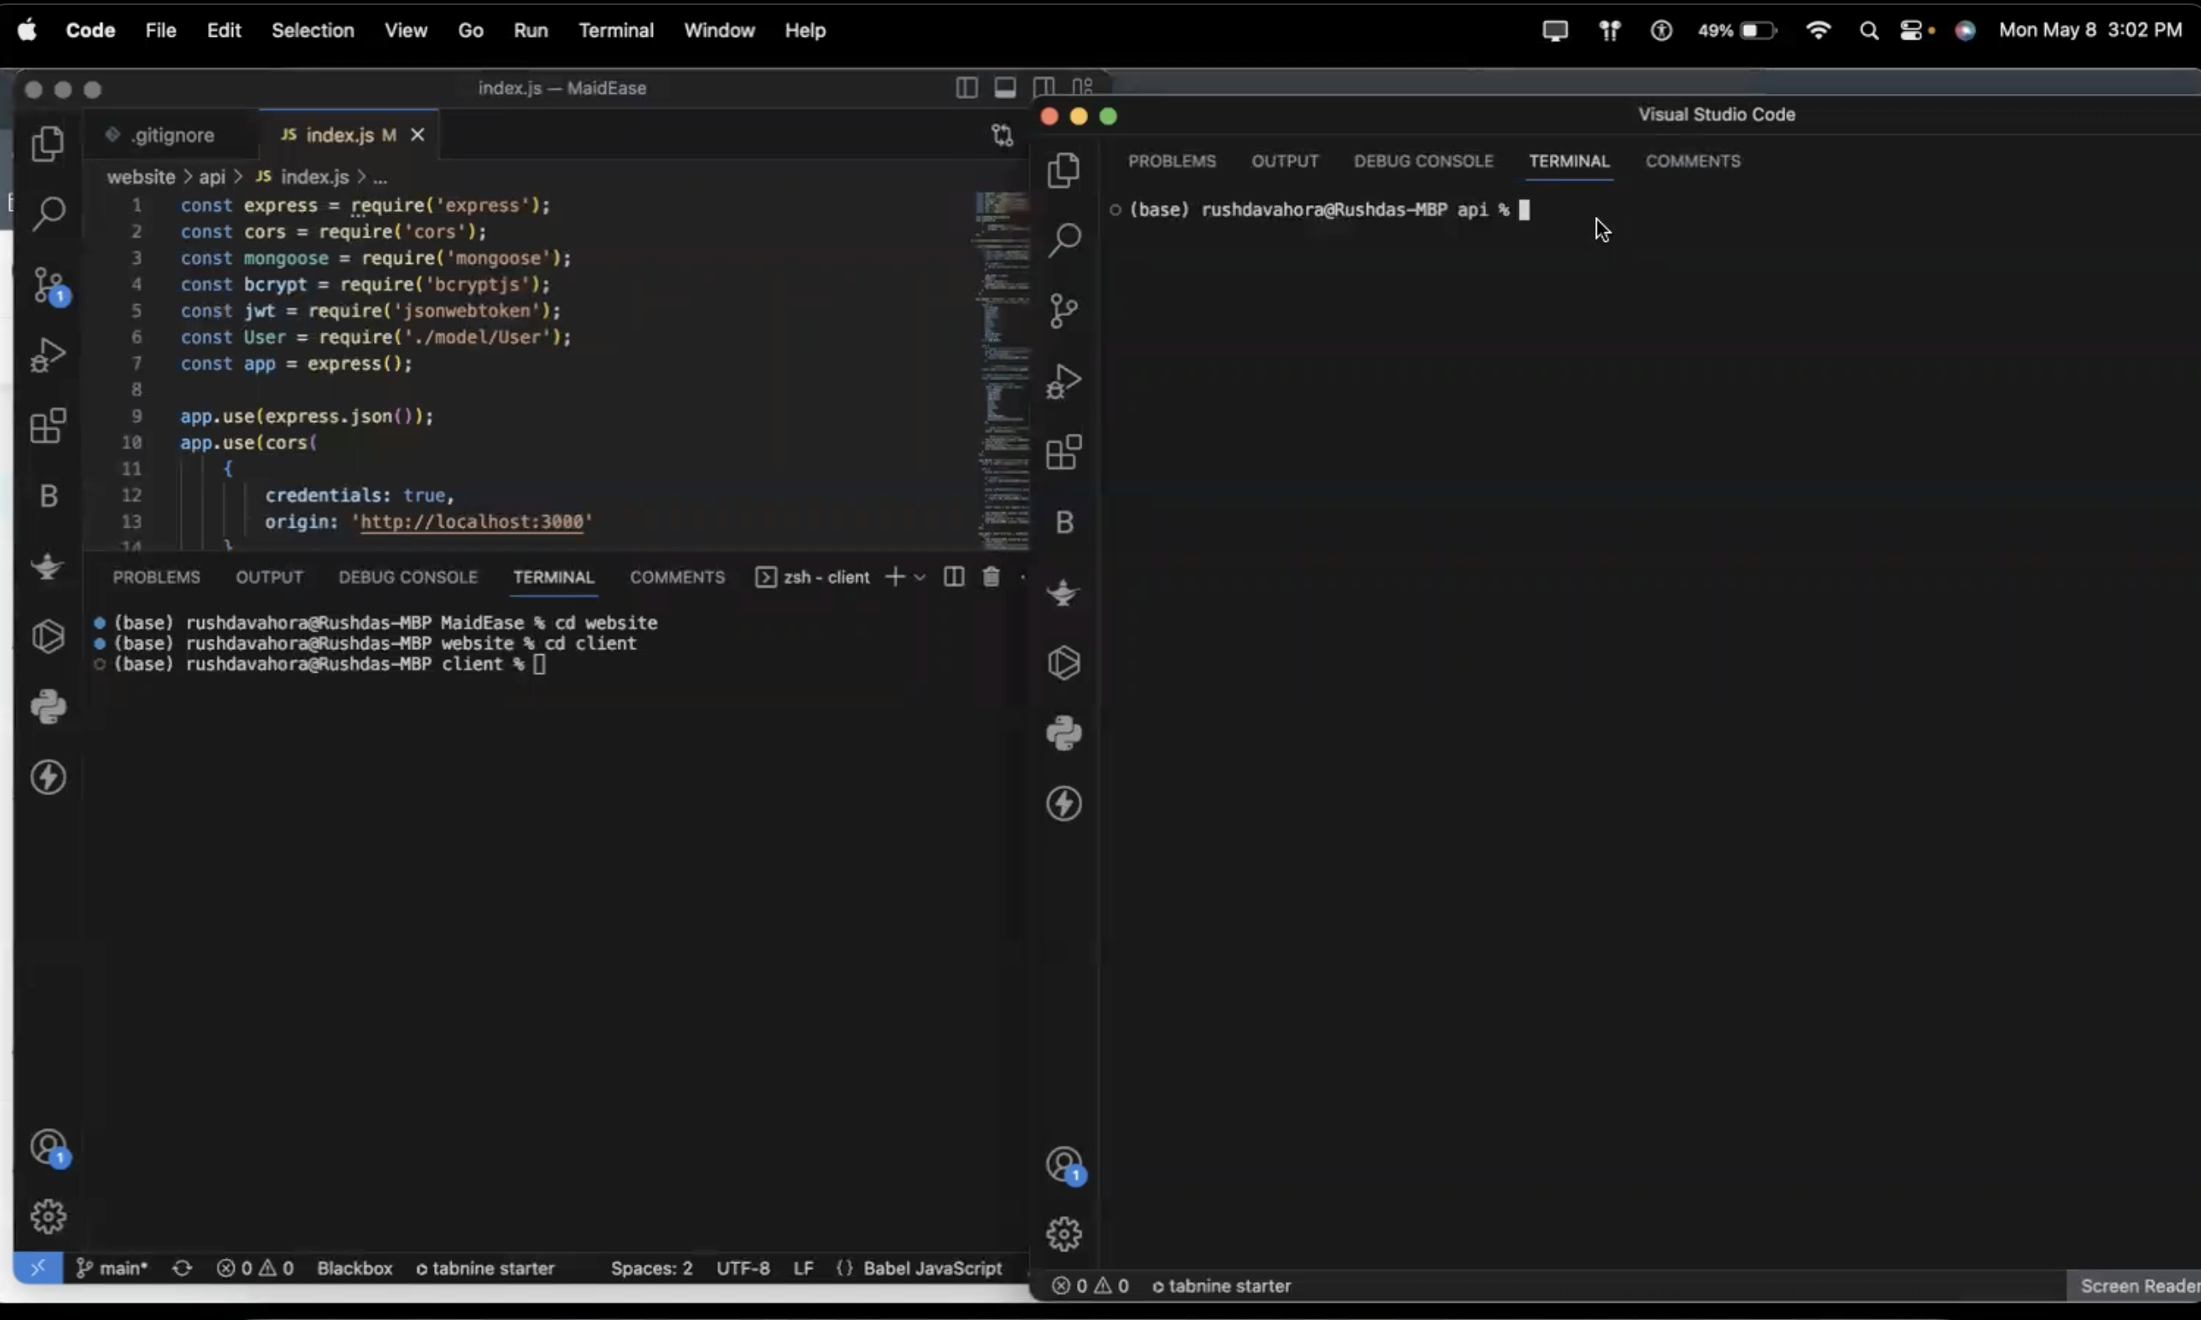
Application Demo
-Nidhi Berde

